Slide 1


Understanding & Predicting Life Expectancy
Scott Schirkofsky Data Science Practicum II Regis University

Slide 2
Overview
The Global Health Observatory indicates that life expectancy globally increased from 66.8 years in 2000 to 73.4 in 2019. Life expectancy is also regarded as the key metric for assessing population’s health. This project seeks to better understand the various factors that affect life expectancy and their relationship with each other and life expectancy itself. The project will also use various machine learning techniques to predict various life expectancy by country and other indicators and provide the metrics needed to evaluate the predictions.
Blog: https://sschirko.edublogs.org/ Github: https://github.com/schirko

Slide 3
Understanding & Predicting Life Expectancy
Life Expectancy | “Life expectancy is a statistical measure of the average time an organism is expected to live, based on the year of its birth, its current age, and other demographic factors including biological sex.” - Wikipedia
Factors | HIV, Polio, Socio-economic, Alcohol & Drug Use, Income, Education, BMI, Country GDP, Population etc.

Slide 4
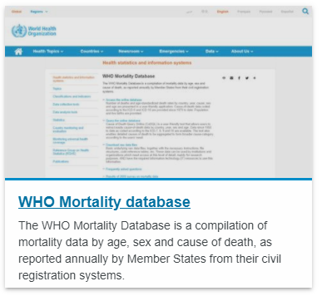
The DATA
Original datasets from The Global Health Observatory (GHO), the data repository for the World Health Organization (WHO). This data tracks the health status and more than health related 1000 indicators for the 193 countries that are members of the United Nations.
2938 rows and 22 columns.
Collected over 15-year period from 2000 to 2015.
Sourced from Kaggle.

Slide 5
Data Science Tasks
Multiple Linear Regression
Decision Tree
Random Forest

Slide 6

analyzing the data
Data Cleaning
Pandas
Data Exploration & Visualization
Pandas, Numpy, Matplotlib, Dataframe, Seaborn,
Splitting Data/ Applying Models
Sklearn, Linear Reg., Multi Reg., Decision Tree, Random Forest, Polynomial, T-test, Accuracy and Evaluation Tests
Matplotlib, Pandas, Seaborn, Tableau

Slide 7
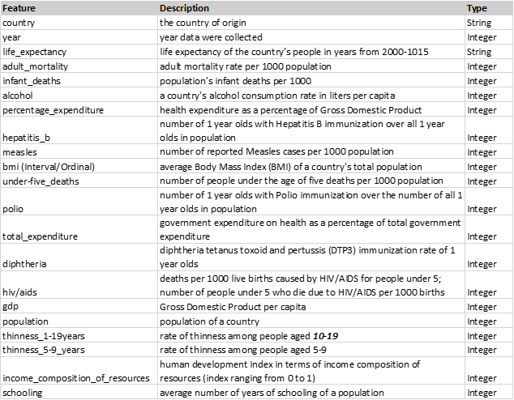
Dataset
This dataset was obtained from Kaggle challenges via the World Health Organization. It is comprised of data from around the world and includes many indicators for each country during the time frame of 2000-2015. The data essentially represents a times series for the countries and features included.

Slide 8
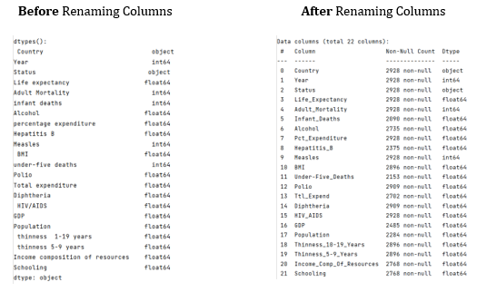
EDA – Renaming Columns

Slide 9
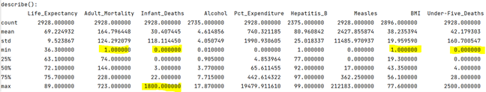
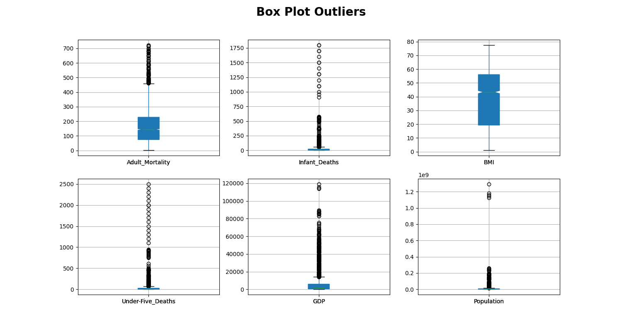
EDA – Missing Values (Inexplicit Nulls)
Adult mortality has a 1 value for min.
Infant Deaths has a min of 0 and max of 1800.
BMI has min of 1.
Under-Five_Deaths has min of 0.

Slide 10
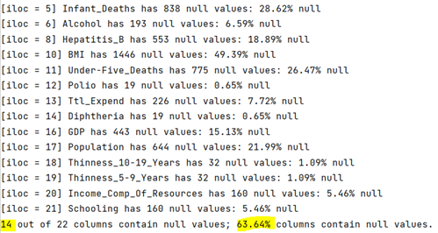
EDA - Missing Values (explicit Nulls)
14 columns that contain nulls, that’s 63.64%!
Big contributors toward remaining null values in the features BMI, Population, GDP, and Infant Deaths.

Slide 11
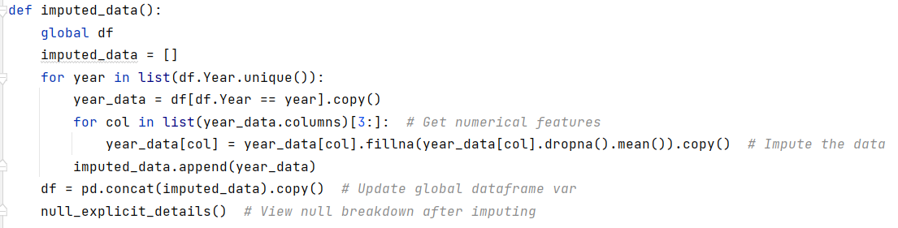

EDA – Missing Values (Imputation)
Imputation can be used to estimate new values for the missing values

Slide 12
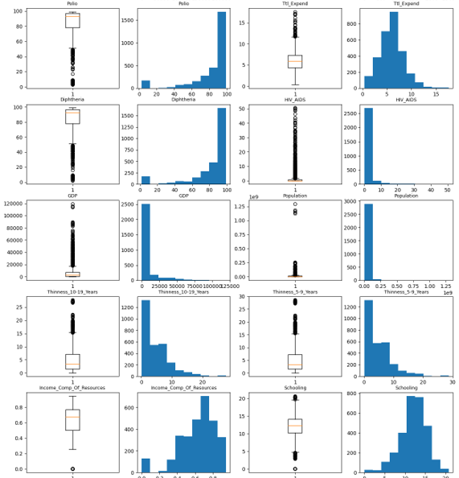
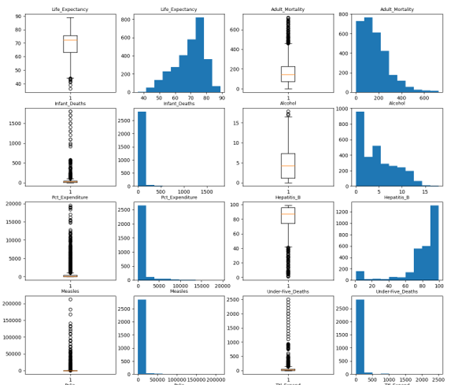
EDA – Outliers (Correlation Matrix)

Slide 13
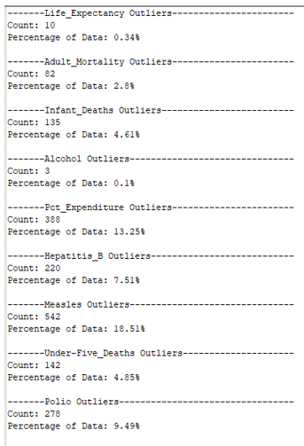
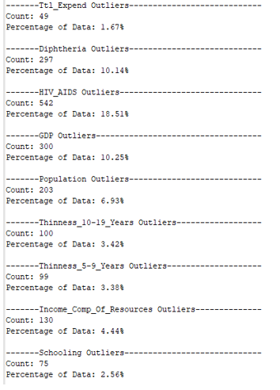
EDA – Outliers (Summary)

Slide 14
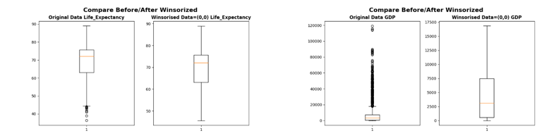
EDA – Outliers (Winsorizing)
Remove outliers by setting upper and lower limits.

Slide 15
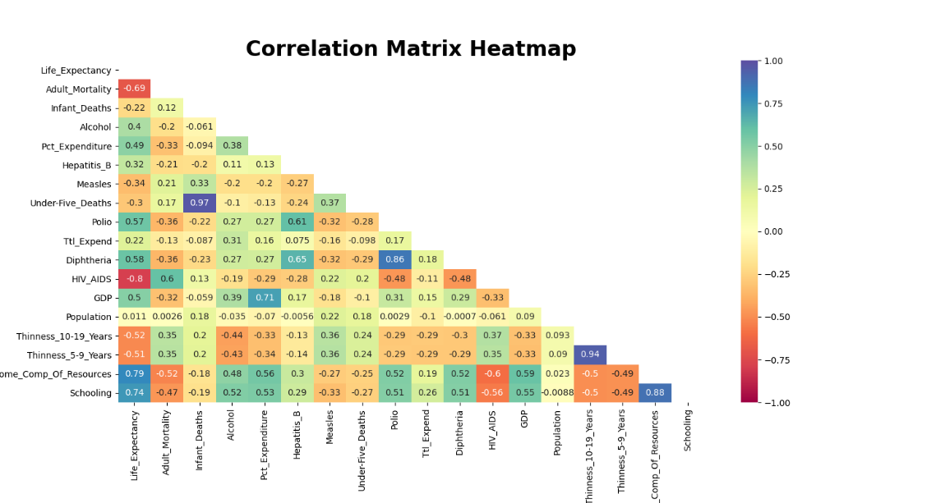
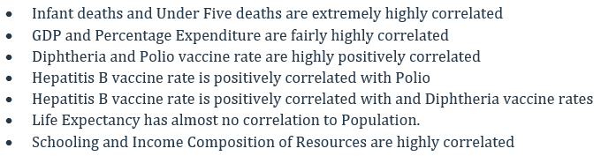
EDA – Correlation Matrix Heatmap

Slide 16
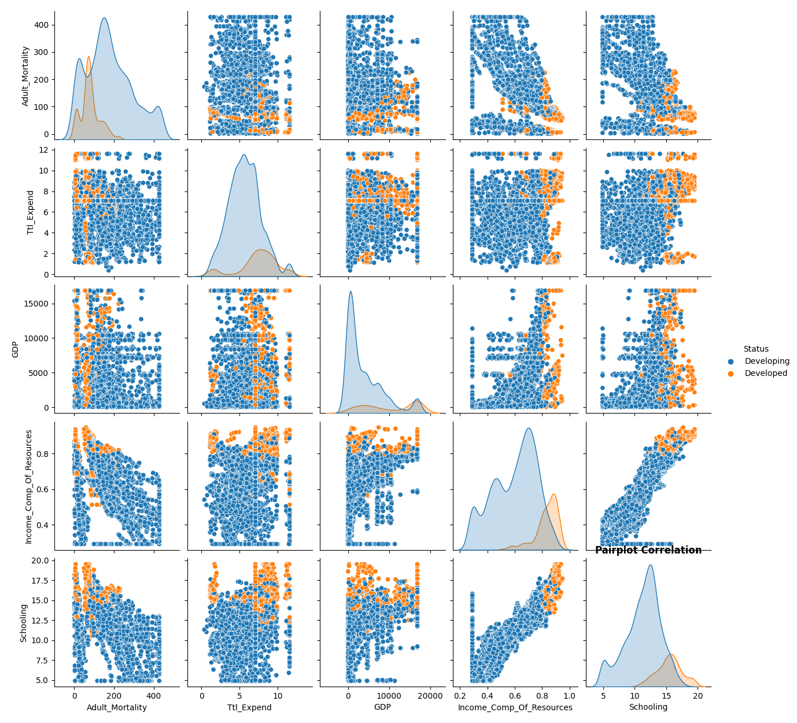
EDA – Feature Pair plots

Slide 17
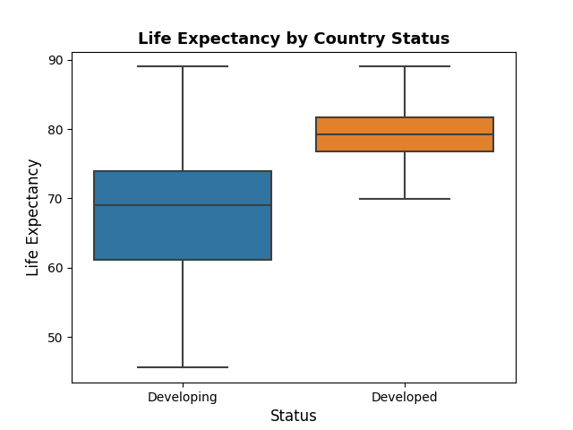
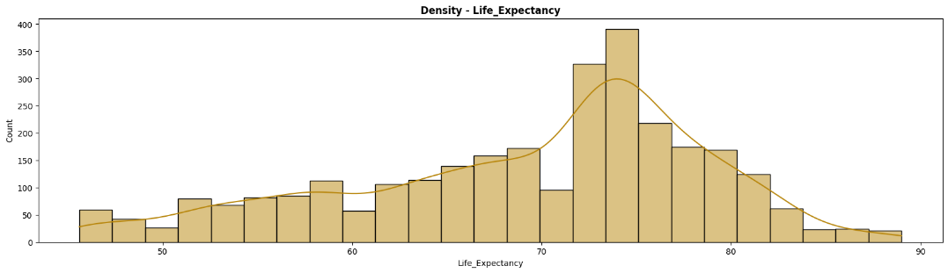
EDA – Life Expectancy

Slide 18
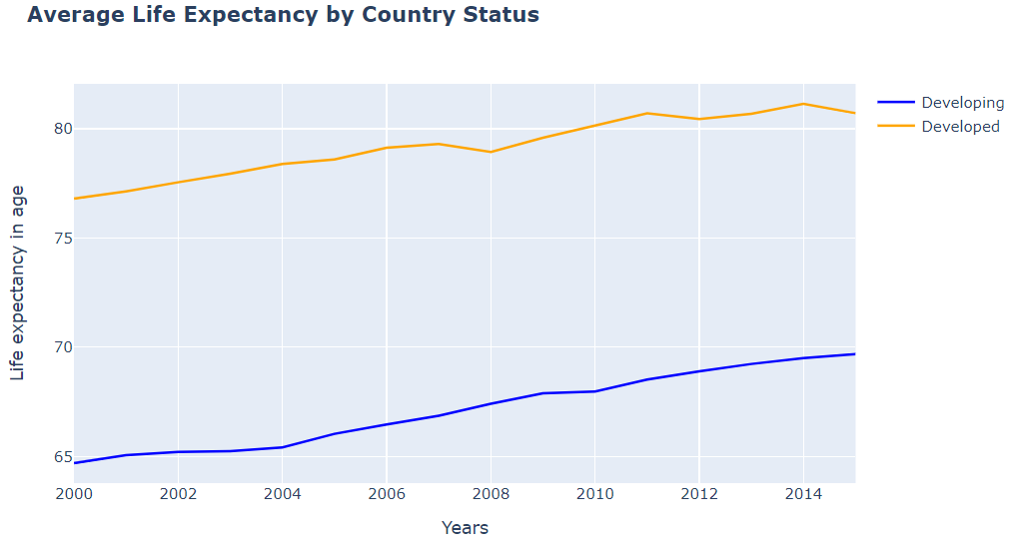
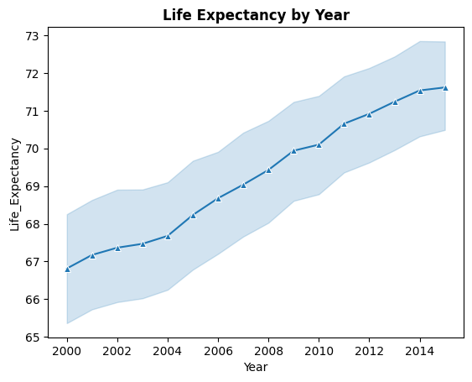
EDA – Life Expectancy

Slide 19
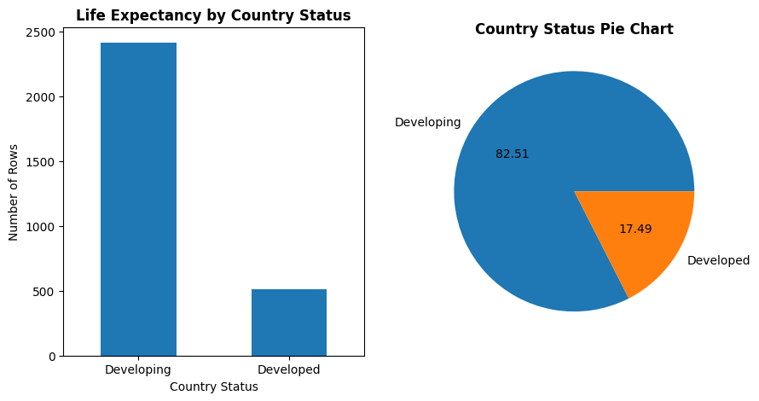
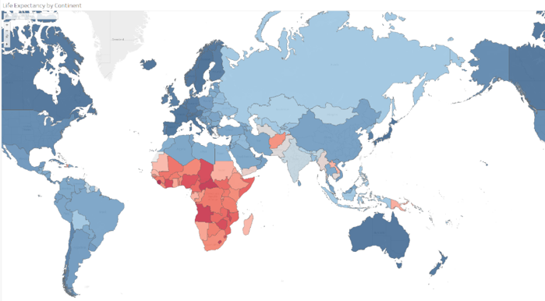
EDA – Life Expectancy

Slide 20
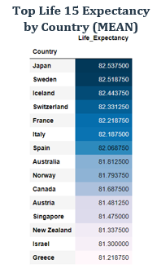
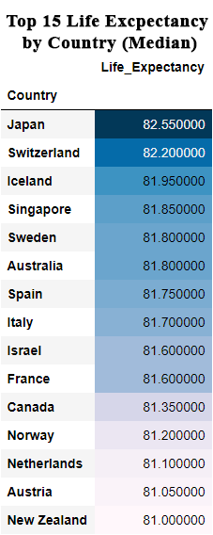
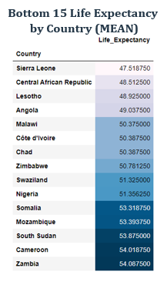
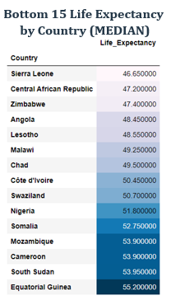
EDA – Rankings

Slide 21
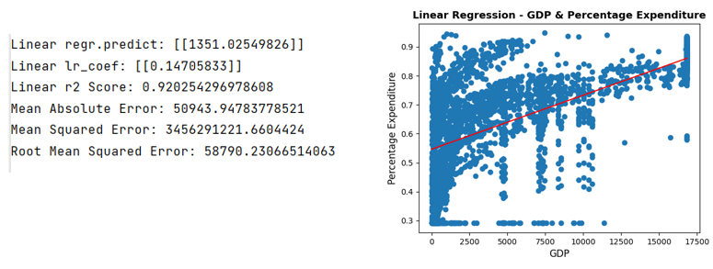
Linear regression

Slide 22
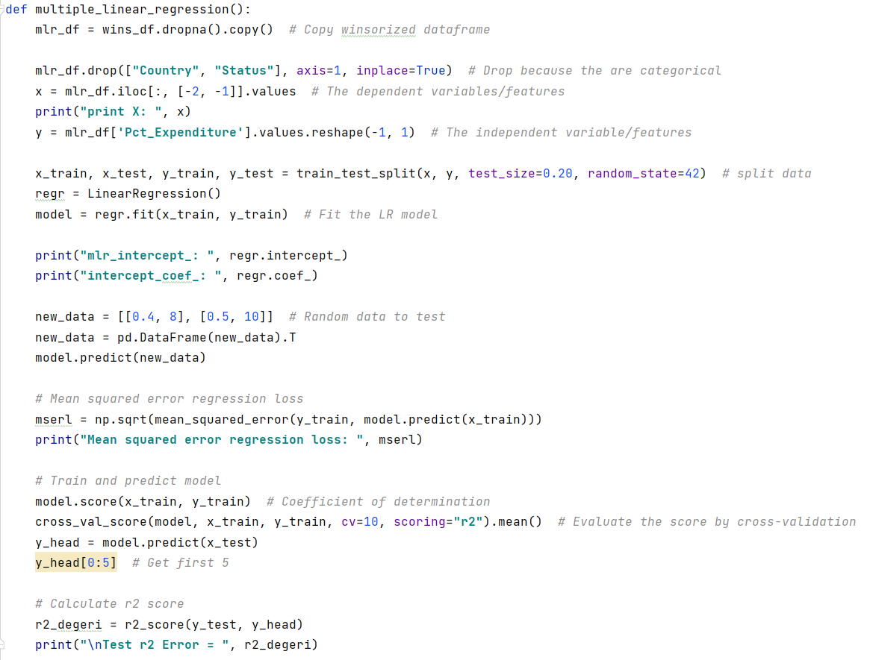
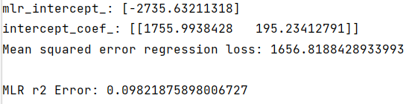
Multiple Linear Regression

Slide 23
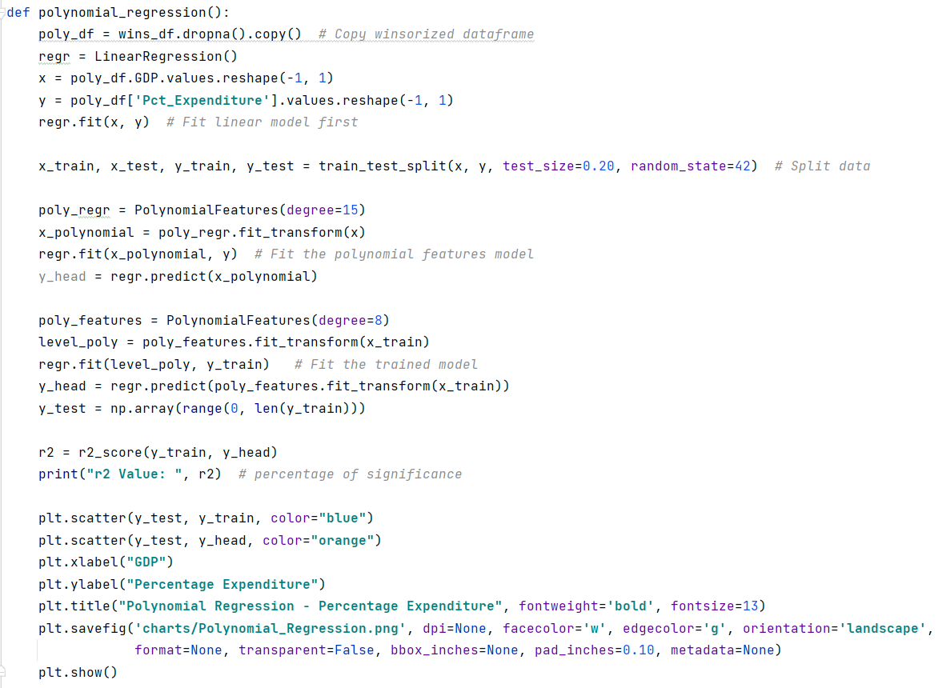
Polynomial Regression

Slide 24
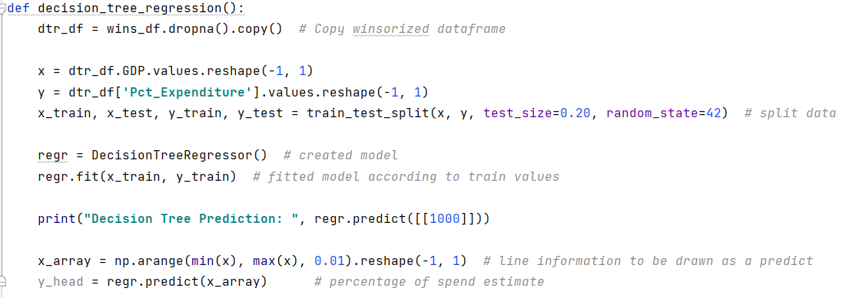
Decision Tree Regression

Slide 25
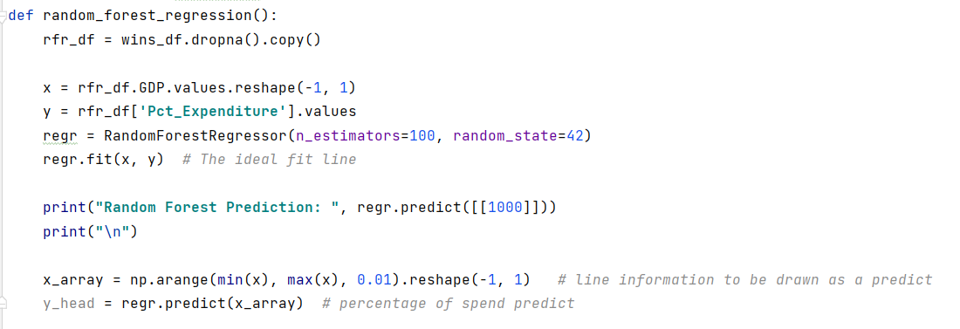
Random Forest Regression

Slide 26
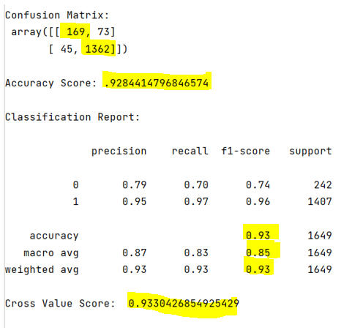
Prediction/ Tune Model

Slide 27
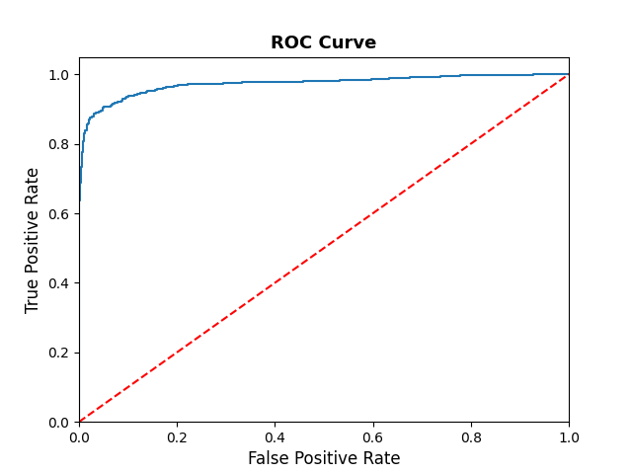
Roc cURVE
Visualize the True False Positives and True False Negatives

Slide 28
Summary
The dataset began with 21 variables that were processed down to 12 independent variables (features) that describe Life Expectancy, the dependent variable.
The data was cleaned by first cleaning up the headings, then detecting and dealt with missing values, both inexplicit and explicit. The data was also imputed and winsorized to address various missing values and outliers. From this a model was born.
A number of machine learning methods were applied to the model including Linear Regression, Multiple Regression, Decision Tree regression, Random Forest Regression, and t-test.
Accuracy metrics like Confusion Matrix, Accuracy Score, Classification Report, and Cross Value Score were run and the model scored an excellent 93% accuracy.

Slide 29
Future Projects/ Questions
While this project was more focused on predictions and the exploratory data process, future projects would benefit from what was learned here.
Additional questions to be answered in future projects:
What is the impact of disease in developed versus developing nations?
What are the impacts of vaccines on Life Expectancy in developing nations?
Which immunizations have the highest correlation to greater life expectancy?
What 5 features would be most impactful on life expectancy in developing countries?

Slide 30
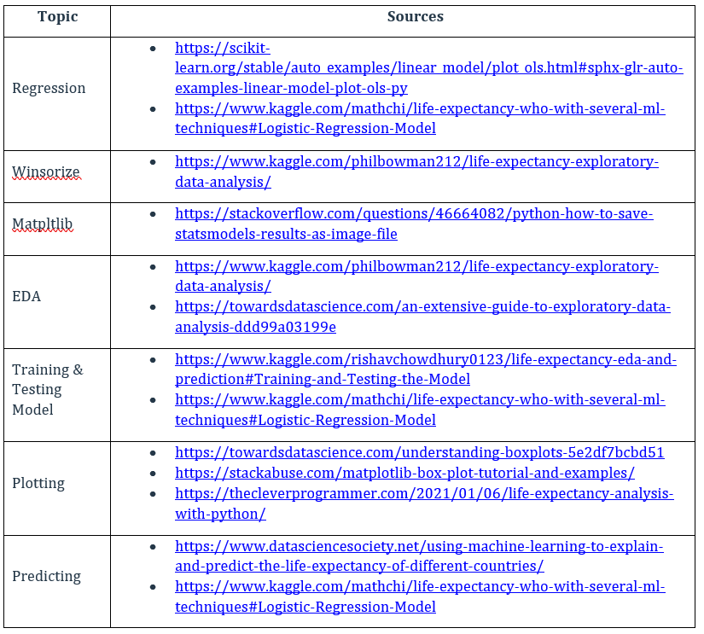
References
Coding and other valuable resources
I wish I could acknowledge each piece of code I used for inspiration but there are far too many to list. So, I’ve listed a few of the more useful resources I used below.

